Slide 1
網路概論實習課L14

Slide 2
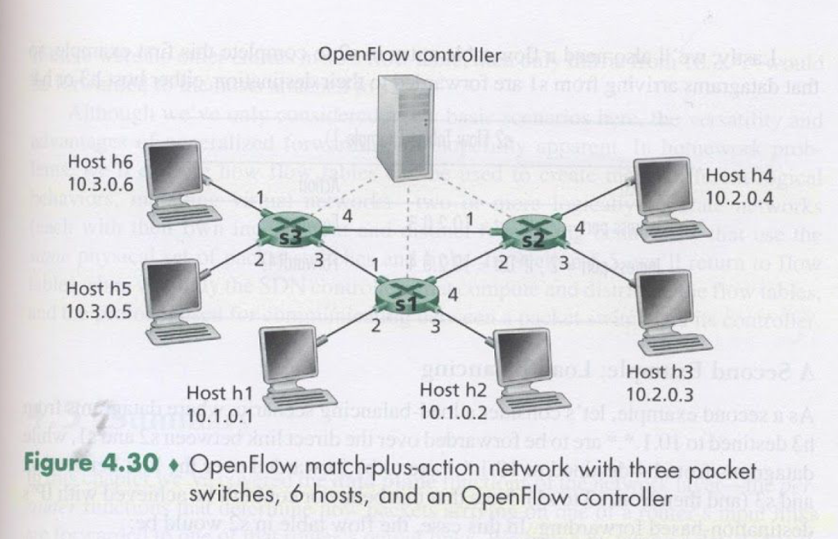

Slide 3
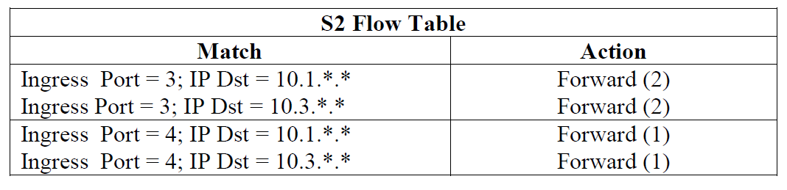
P20.Consider again the SDN OpenFlow network shown in Figure 4.30 . Suppose that the desired forwarding behavior for datagrams arriving from hosts h3 or h4 at S2 is as follows:
Any datagrams arriving from host h3 and destined for h1,h2,h5 or h6 should be forwarded in a clockwise direction in network
Any datagrams arriving from host h4 and destined for h1,h2,h5 or h6 should be forwarded in a counter-clockwise direction in network

Slide 4
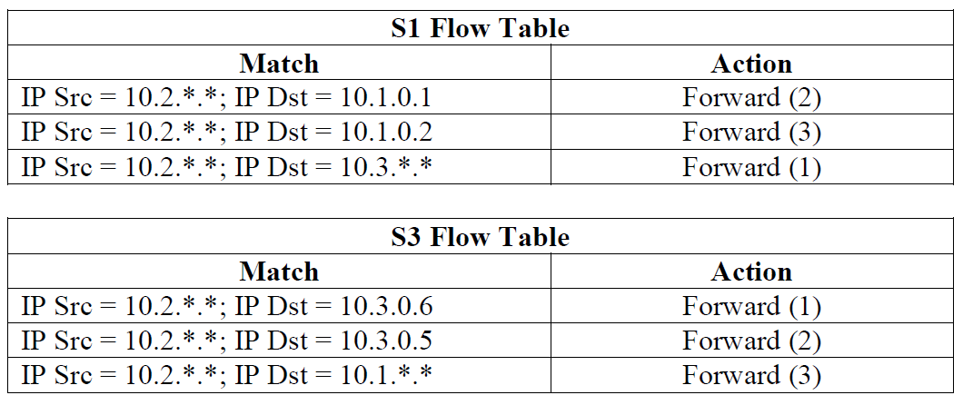
P21.Consider again the scenario from P19 above. Give the flow tables entries at packet switches s1 and s3 , such that any arriving datagrams with a source address of h3 or h4 are routed to the destination hosts specified in the destination address field in the IP datagram.

Slide 5
P22.Consider again the SDN OpenFlow network shown in Figure 4.30. Suppose we want switch s2 to function as firewall . Specify the flow table in s2 that implements the following firewall behaviors for delivery of datagrams destined to h3 and h4 . You do not need to specify the forwarding behavior in s2 that forwards traffic to other routers.
Only traffic arriving from hosts h1 and h6 should be delivered to hosts h3 or h4
Only TCP traffic is allowed to be delivered to hosts h3 or h4
Only traffic destined to h3 is to be delivered
Only UDP traffic from h1 and destined to h3 is to be delivered . All other traffic is blocked .

Slide 6
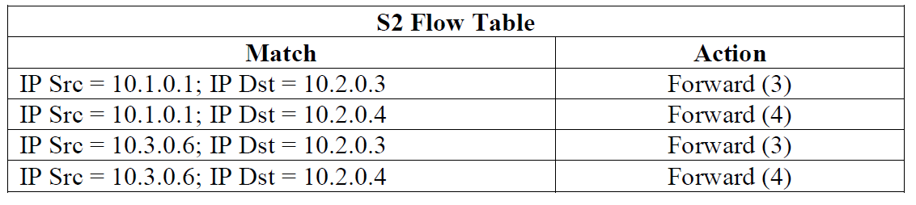
1. h1,h6 -> h3,h4

Slide 7
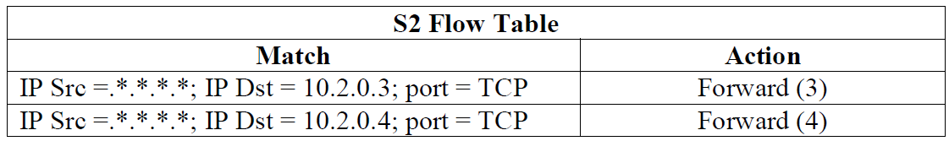
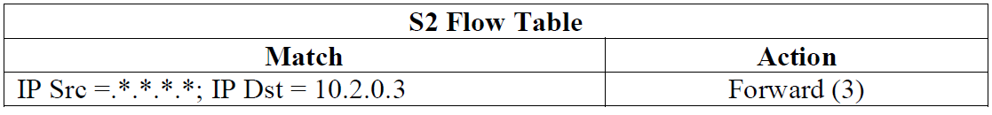
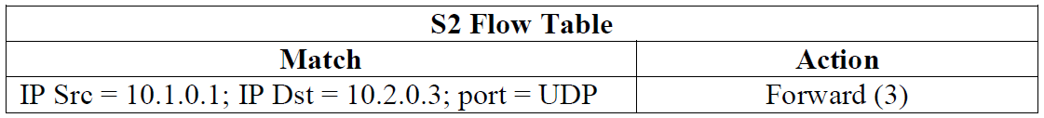
2. Port TCP ->h3,h4
3.any->h3
4.Port UDP h1->h3

